Slide 1

UNIT 2:
CLASSIFIERS BASED ON
BAYES DECISION THEORY

Slide 2
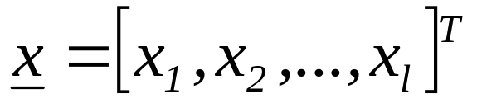

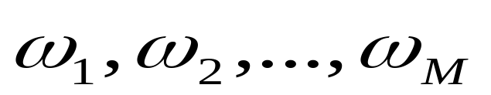
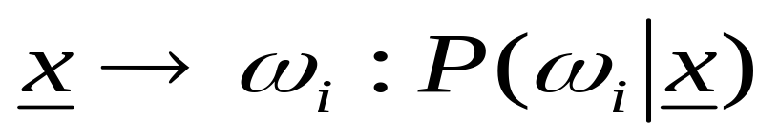
CLASSIFIERS BASED ON BAYES DECISION THEORY
Statistical nature of feature vectors
Assign the pattern represented by feature vector
to the most probable of the available classes
That is
maximum

Slide 3

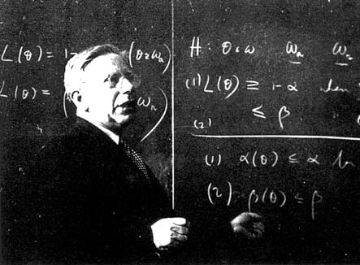
CLASSIFIERS BASED ON BAYES DECISION THEORY
Abraham Wald (1902-1950)
Thomas Bayes (1707-1761)

Slide 4

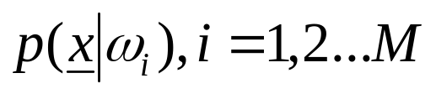
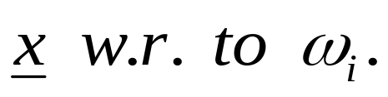
Computation of a-posteriori probabilities
  Assume known
    a-priori probabilities
    This is also known as the likelihood of

Slide 5
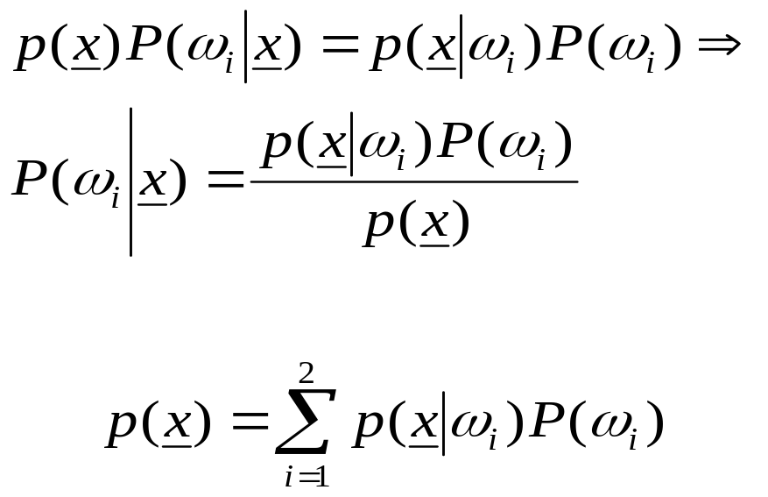
  The Bayes rule (Μ=2)
where

Slide 6

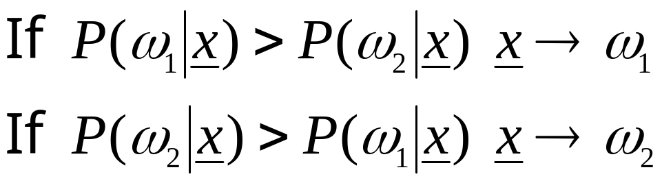

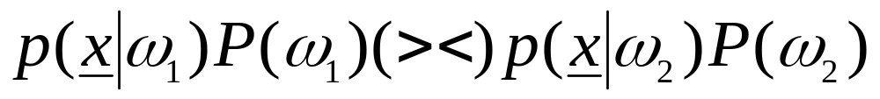
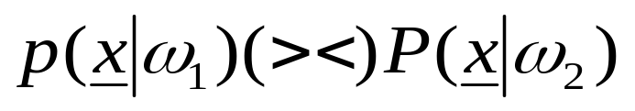
The Bayes classification rule (for two classes M=2)
  Given classify it according to the rule
  Equivalently: classify according to the rule
  For equiprobable classes the test becomes

Slide 7
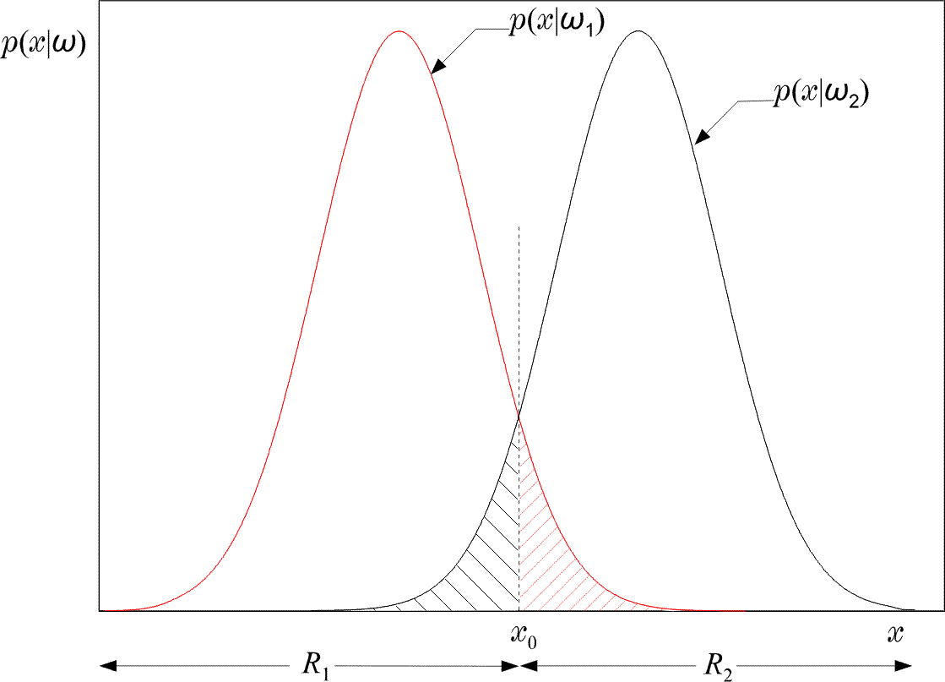
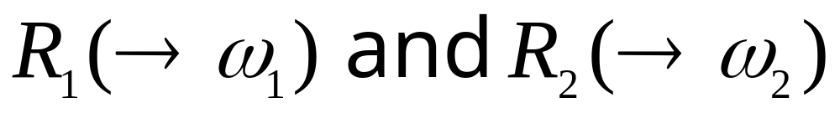

Slide 8
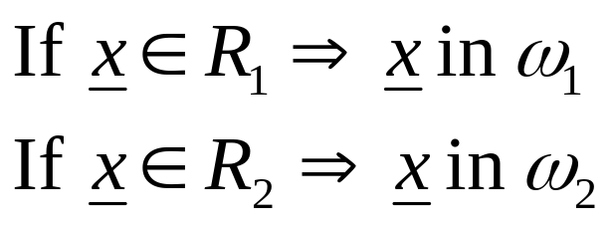
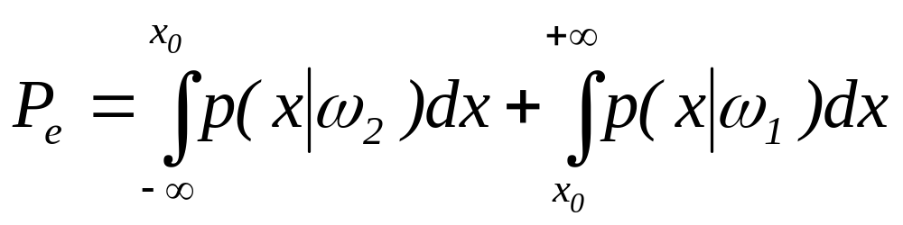
Equivalently in words: Divide space in two regions
Probability of error
  Total shaded area
Bayesian classifier is OPTIMAL with respect to minimising the classification error probability!!!!

Slide 9
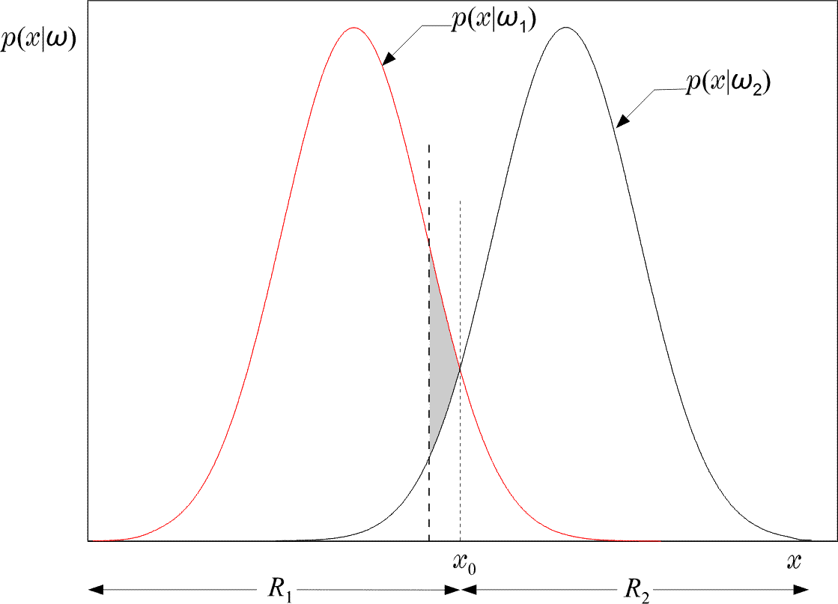
  Indeed: Moving the threshold the total shaded area INCREASES by the extra “grey” area.

Slide 10

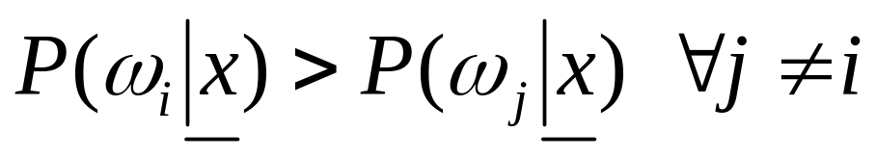
The Bayes classification rule for many (M>2) classes:
  Given classify it to if:
  Such a choice also minimizes the classification error probability
Minimizing the average risk
  For each wrong decision, a penalty term is assigned since some decisions are more sensitive than others

Slide 11
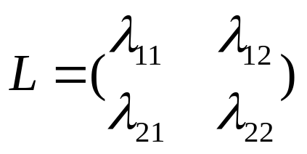

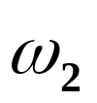

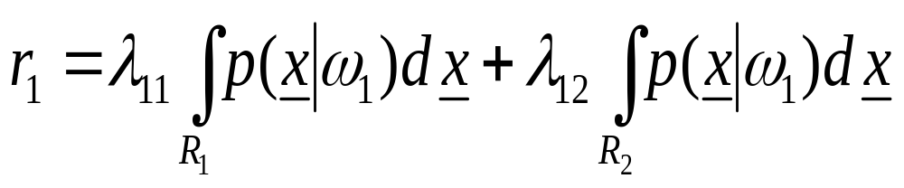
  For M=2
    Define the loss matrix
    penalty term for deciding class ,
    although the pattern belongs to , etc.
  Risk with respect to

Slide 12
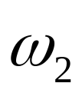
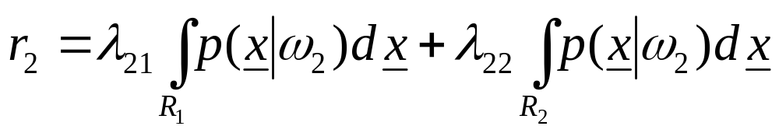

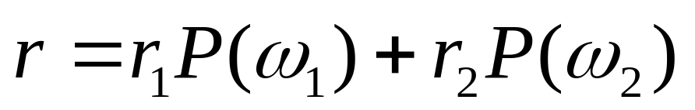
  Risk with respect to
  Average risk
Probabilities of wrong decisions, weighted by the penalty terms

Slide 13


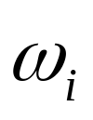
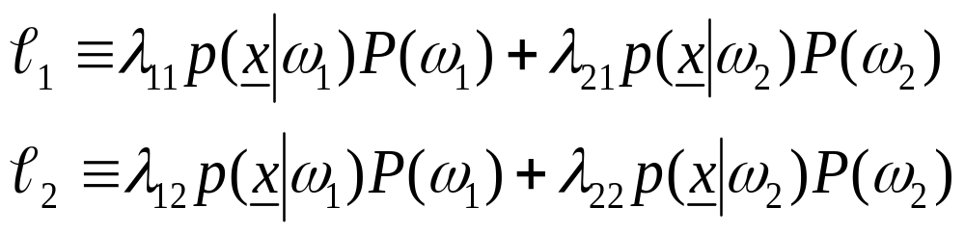
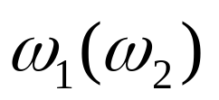
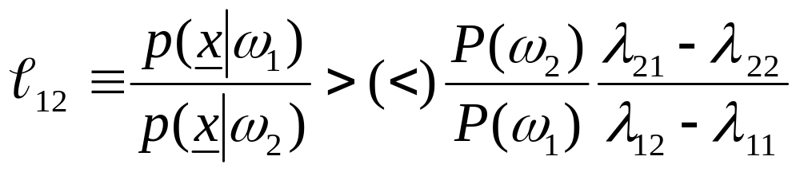
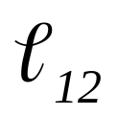
Choose and so that r is minimized
Then assign to if
Equivalently:
assign x in if
: likelihood ratio

Slide 14
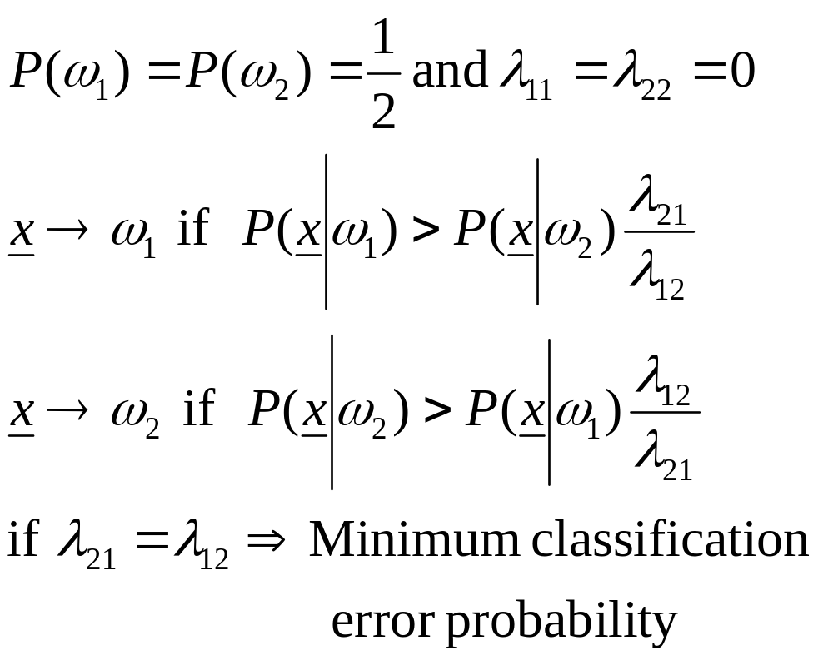
If

Slide 15
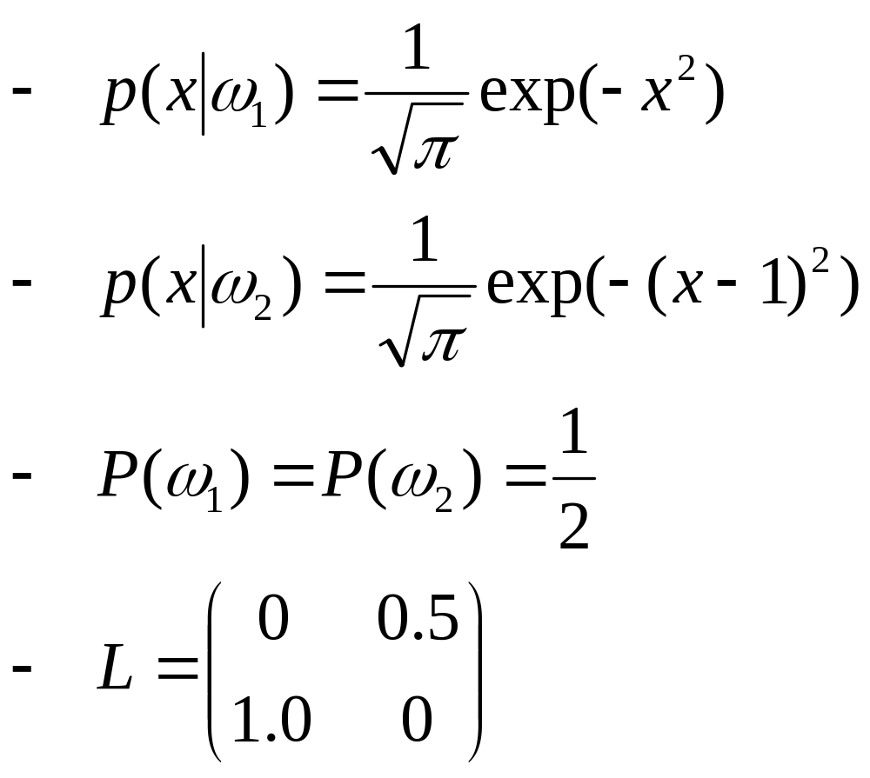
An example:

Slide 16
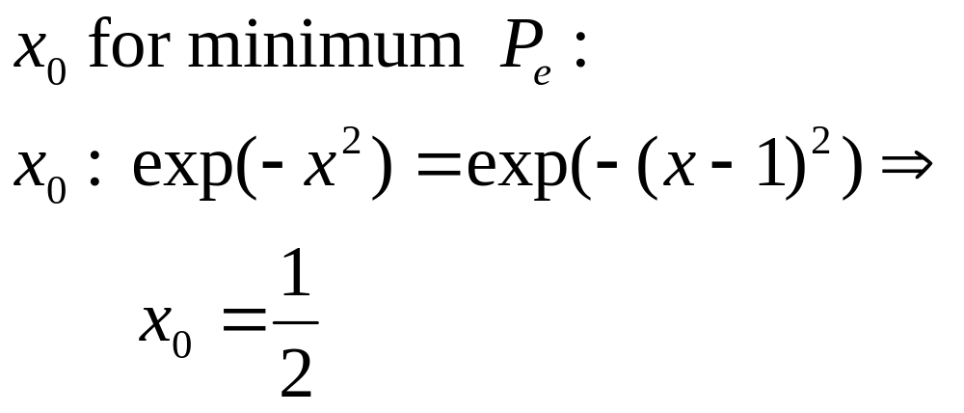
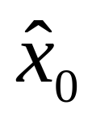
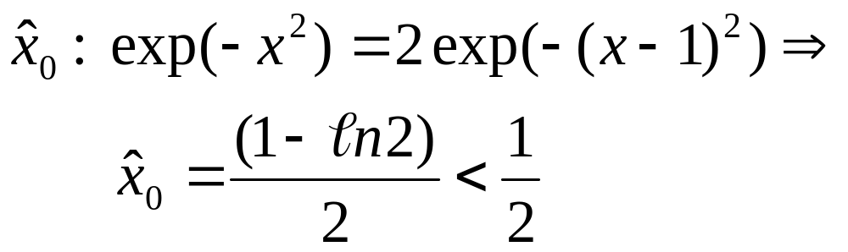
  Then the threshold value is:
  Threshold for minimum r

Slide 17
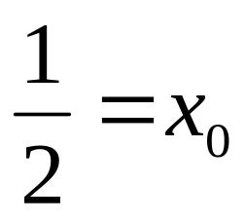
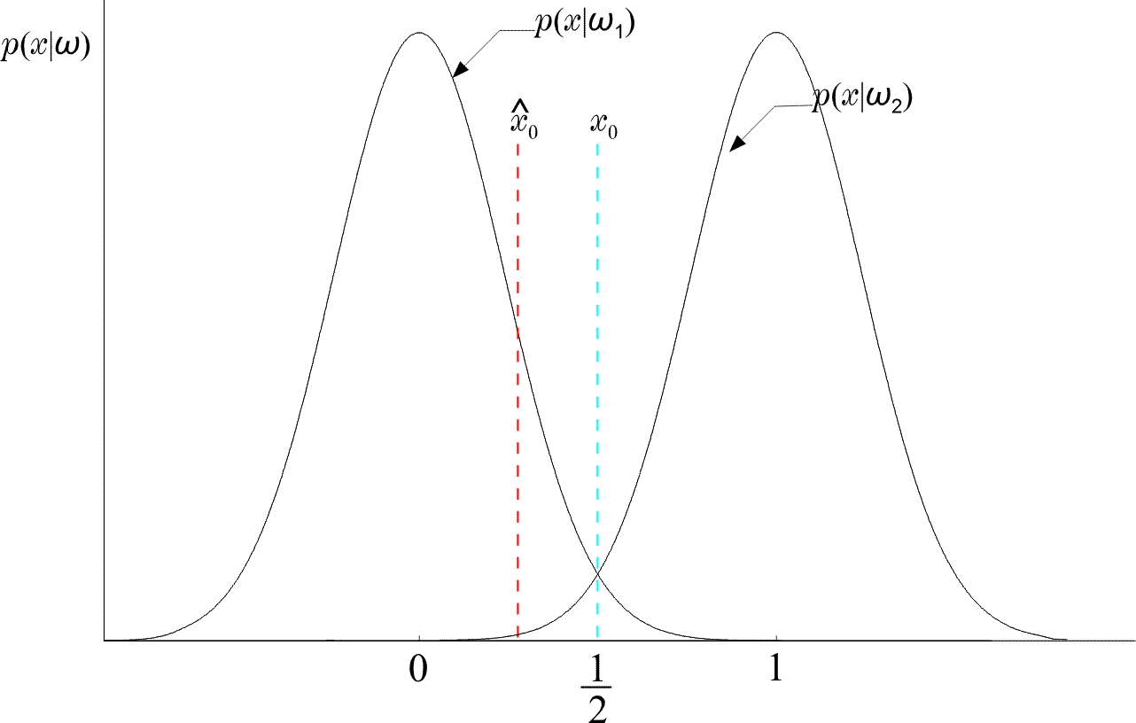
  Thus moves to the left of
  (WHY?)

Slide 18
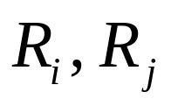
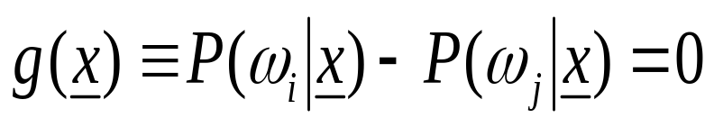
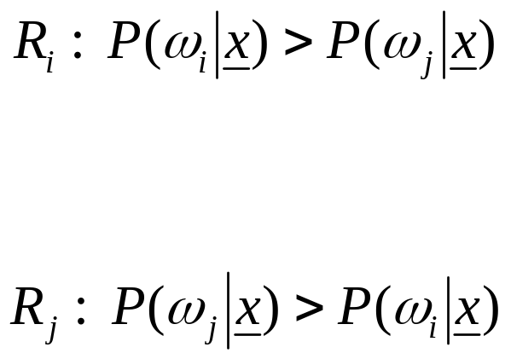

DISCRIMINANT FUNCTIONS
DECISION SURFACES
If are contiguous:
is the surface separating the regions. On one side is positive (+), on the other is negative (-). It is known as Decision Surface
+
-

Slide 19
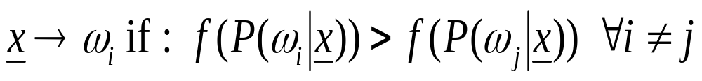
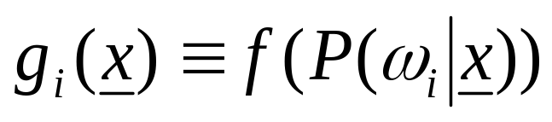
If f(.) monotonic, the rule remains the same if we use:
is a discriminant function
In general, discriminant functions can be defined independent of the Bayesian rule. They lead to suboptimal solutions, yet if chosen appropriately, can be computationally more tractable.

Slide 20
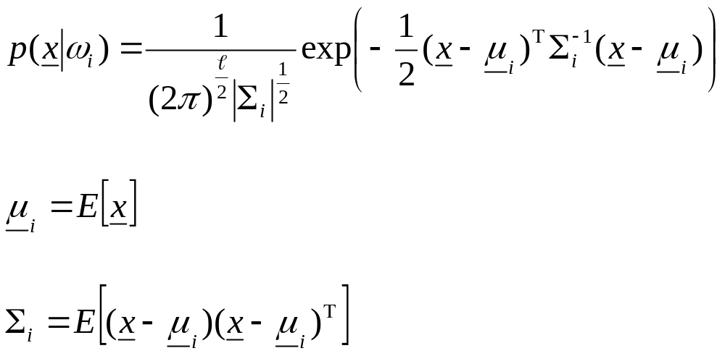
BAYESIAN CLASSIFIER FOR NORMAL DISTRIBUTIONS
Multivariate Gaussian pdf
  called covariance matrix

Slide 21
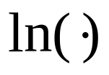
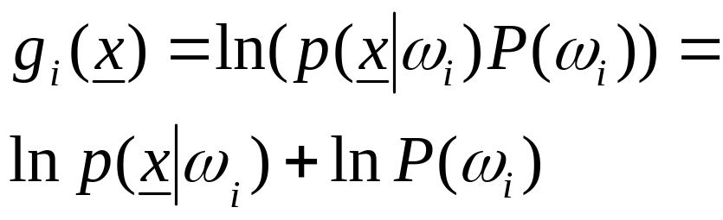
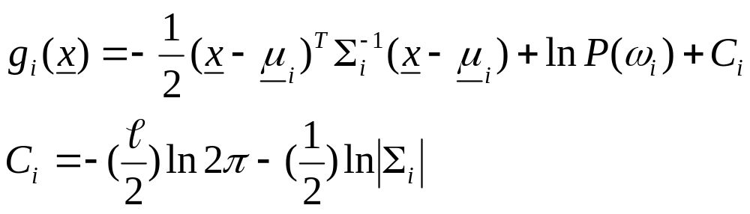
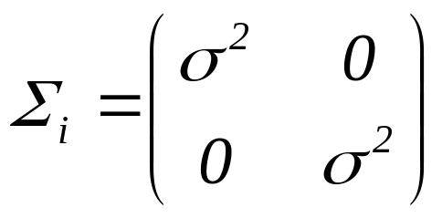
is monotonic. Define:
  Example:

Slide 22
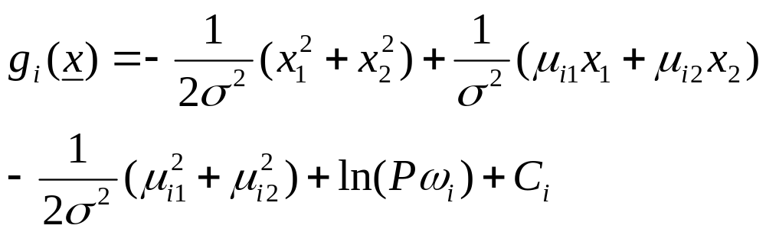
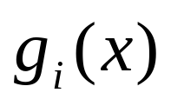
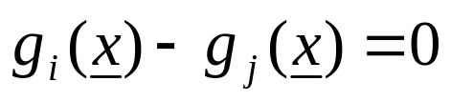
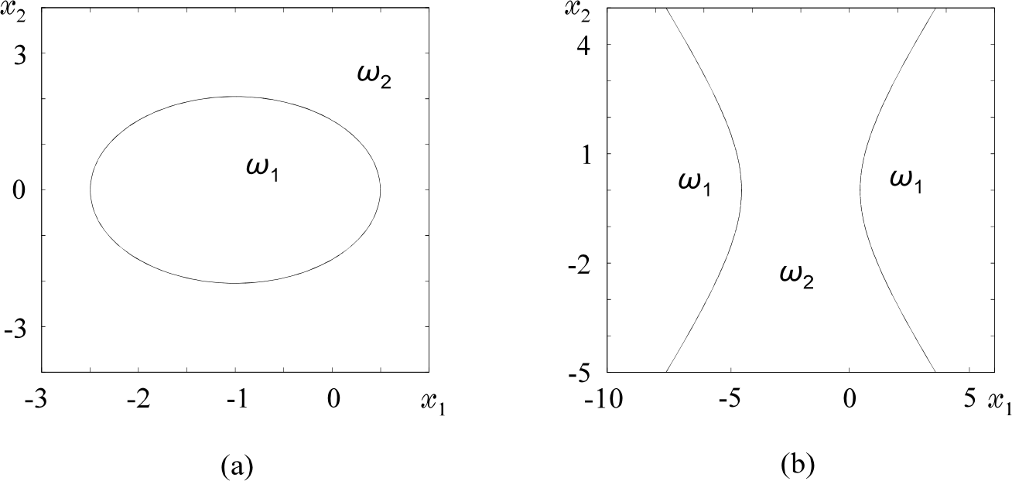
  That is, is quadratic and the surfaces
    quadrics, ellipsoids, parabolas, hyperbolas,
    pairs of lines.
  For example:

Slide 23
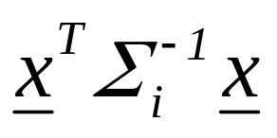
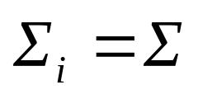

Decision Hyperplanes
  Quadratic terms:
  If ALL (the same) the quadratic terms are not of interest. They are not involved in comparisons. Then, equivalently, we can write:
  Discriminant functions are LINEAR

Slide 24


  Let in addition:

Slide 25





  Nondiagonal:
  Decision hyperplane

Slide 26






Minimum Distance Classifiers
  equiprobable
  Euclidean Distance:
  smaller
  Mahalanobis Distance:
  smaller

Slide 27


Slide 28



Example:

Slide 29

ESTIMATION OF UNKNOWN PROBABILITY
DENSITY FUNCTIONS
Maximum Likelihood

Slide 30


Slide 31


Slide 32

  Asymptotically unbiased and consistent

Slide 33

Example:

Slide 34



Maximum Aposteriori Probability Estimation
  In ML method, θ was considered as a parameter
  Here we shall look at θ as a random vector described by a pdf p(θ), assumed to be known
  Given
  Compute the maximum of
  From Bayes theorem

Slide 35

  The method:

Slide 36


Slide 37

Example:

Slide 38

Bayesian Inference

Slide 39



Slide 40




  The above is a sequence of Gaussians as
Maximum Entropy
  Entropy

Slide 41




  Example: x is nonzero in the interval
  and zero otherwise. Compute the ME pdf
    The constraint:
    Lagrange Multipliers

Slide 42




Nonparametric Estimation

Slide 43

Parzen Windows
  Divide the multidimensional space in hypercubes

Slide 44





  Define
    That is, it is 1 inside a unit side hypercube centered at 0
    The problem:
    Parzen windows-kernels-potential functions

Slide 45

  Variance
    The smaller the h the higher the variance
h=0.1, N=1000
h=0.8, N=1000

Slide 46

h=0.1, N=10000
  The higher the N the better the accuracy

Slide 47



  If
  asymptotically unbiased
  The method
    Remember:

Slide 48
CURSE OF DIMENSIONALITY
  In all the methods, so far, we saw that the highest the number of points, N, the better the resulting estimate.
  If in the one-dimensional space an interval, filled with N points, is adequately (for good estimation), in the two-dimensional space the corresponding square will require N² and in the ℓ-dimensional space the ℓ-dimensional cube will require N^{ℓ} points.
  The exponential increase in the number of necessary points in known as the curse of dimensionality. This is a major problem one is confronted with in high dimensional spaces.

Slide 49



NAIVE – BAYES CLASSIFIER
  Let and the goal is to estimate
  i = 1, 2, …, M. For a “good” estimate of the pdf one would need, say, N^{ℓ} points.
  Assume x₁, x₂ ,…, x_{ℓ} mutually independent. Then:
  In this case, one would require, roughly, N points for each pdf. Thus, a number of points of the order N·ℓ would suffice.
  It turns out that the Naïve – Bayes classifier works reasonably well even in cases that violate the independence assumption.

Slide 50


K Nearest Neighbor Density Estimation
  In Parzen:
    The volume is constant
    The number of points in the volume is varying
  Now:
    Keep the number of points
    constant
    Leave the volume to be varying

Slide 51



Slide 52


The Nearest Neighbor Rule
  Choose k out of the N training vectors, identify the k nearest ones to x
  Out of these k identify k_{i} that belong to class ω_{i}
  The simplest version
  k=1 !!!
  For large N this is not bad. It can be shown that:
  if P_{B} is the optimal Bayesian error probability, then:

Slide 53



  For small P_{B}:

Slide 54


Voronoi tesselation

Slide 55



BAYESIAN NETWORKS
Bayes Probability Chain Rule
  Assume now that the conditional dependence for each x_{i} is limited to a subset of the features appearing in each of the product terms. That is:
  where

Slide 56


  For example, if ℓ=6, then we could assume:
  Then:
  The above is a generalization of the Naïve – Bayes. For the Naïve – Bayes the assumption is:
  A_{i} = Ø, for i=1, 2, …, ℓ

Slide 57


  A graphical way to portray conditional dependencies is given below
  According to this figure we have that:
    x₆ is conditionally dependent on x₄, x₅.
    x₅ on x₄
    x₄ on x₁, x₂
    x₃ on x₂
    x₁, x₂ are conditionally independent on other variables.
  For this case:

Slide 58
Bayesian Networks
  Definition: A Bayesian Network is a directed acyclic graph (DAG) where the nodes correspond to random variables. Each node is associated with a set of conditional probabilities (densities), p(x_{i}|A_{i}), where x_{i} is the variable associated with the node and A_{i} is the set of its parents in the graph.
  A Bayesian Network is specified by:
    The marginal probabilities of its root nodes.
    The conditional probabilities of the non-root nodes, given their parents, for ALL possible combinations.

Slide 59

  The figure below is an example of a Bayesian Network corresponding to a paradigm from the medical applications field.
  This Bayesian network models conditional dependencies for an example concerning smokers (S), tendencies to develop cancer (C) and heart disease (H), together with variables corresponding to heart (H1, H2) and cancer (C1, C2) medical tests.

Slide 60
  Once a DAG has been constructed, the joint probability can be obtained by multiplying the marginal (root nodes) and the conditional (non-root nodes) probabilities.
  Training: Once a topology is given, probabilities are estimated via the training data set. There are also methods that learn the topology.
  Probability Inference: This is the most common task that Bayesian networks help us to solve efficiently. Given the values of some of the variables in the graph, known as evidence, the goal is to compute the conditional probabilities for some of the other variables, given the evidence.

Slide 61

Example: Consider the Bayesian network of the figure:
a) If x is measured to be x=1 (x1), compute P(w=0|x=1) [P(w0|x1)].
b) If w is measured to be w=1 (w1) compute P(x=0|w=1) [ P(x0|w1)].

Slide 62
  For a), a set of calculations are required that propagate from node x to node w. It turns out that P(w0|x1) = 0.63.
  For b), the propagation is reversed in direction. It turns out that P(x0|w1) = 0.4.
  In general, the required inference information is computed via a combined process of “message passing” among the nodes of the DAG.
Complexity:
  For singly connected graphs, message passing algorithms amount to a complexity linear in the number of nodes.

Slide 63




Example
0 = NO
1 = YES
VISIT TO COUNTRY: X
HIGH RISK AREA: Y
HAS DISEASE: Z
CLINICAL TEST: W

Slide 64
Inference
Answer questions like:
What is the probability of a person having caught the disease given that he/she has visited the high risk country?
What is the probability of the clinical test of someone coming out positive, given that he/she has visited the high risk country?
Given that the clinical test of a person has come out positive, what is the probability that he/she has visited the high risk country?
Given that the clinical test of a person has come out positive, what is the probability that he/she has the disease?

Slide 65
Inference
0 = NO
1 = YES
VISIT TO COUNTRY: X
YES: x=x1
HIGH RISK AREA: Y
?
HAS DISEASE: Z
CLINICAL TEST: W
?

Slide 66
Inference
0 = NO
1 = YES
VISIT TO COUNTRY: X
?
HIGH RISK AREA: Y
?
HAS DISEASE: Z
CLINICAL TEST: W
YES: w=w1

